Slide 1
Mmm… Tasty?
Notes:
1

Slide 2
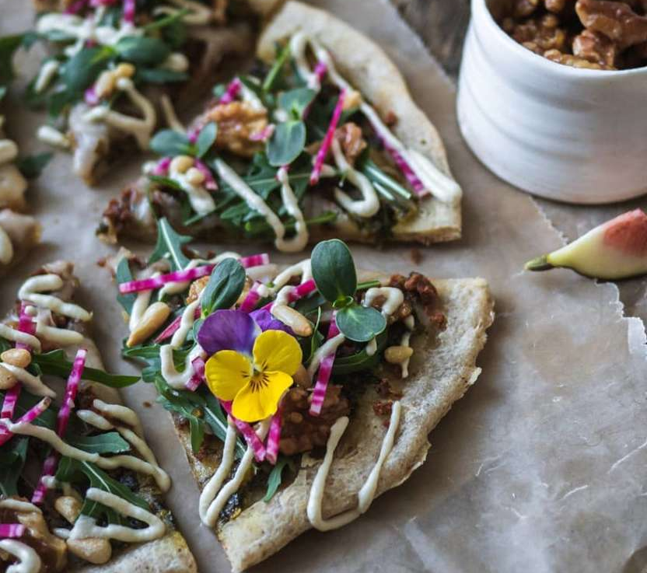
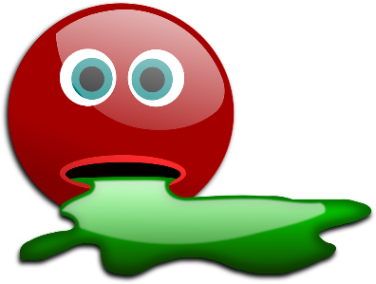
Umm… Would You Eat This?!

Slide 3
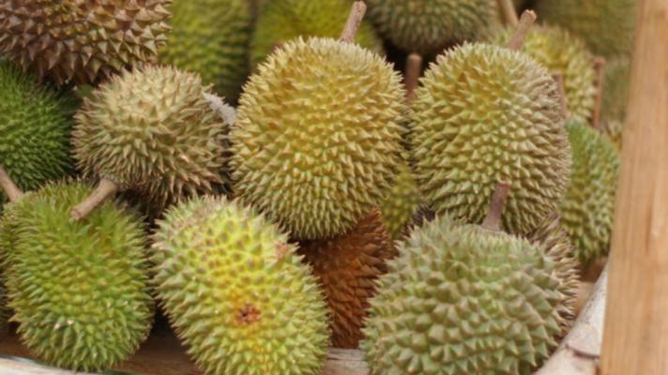
Umm… Would You Eat This?!

Slide 4
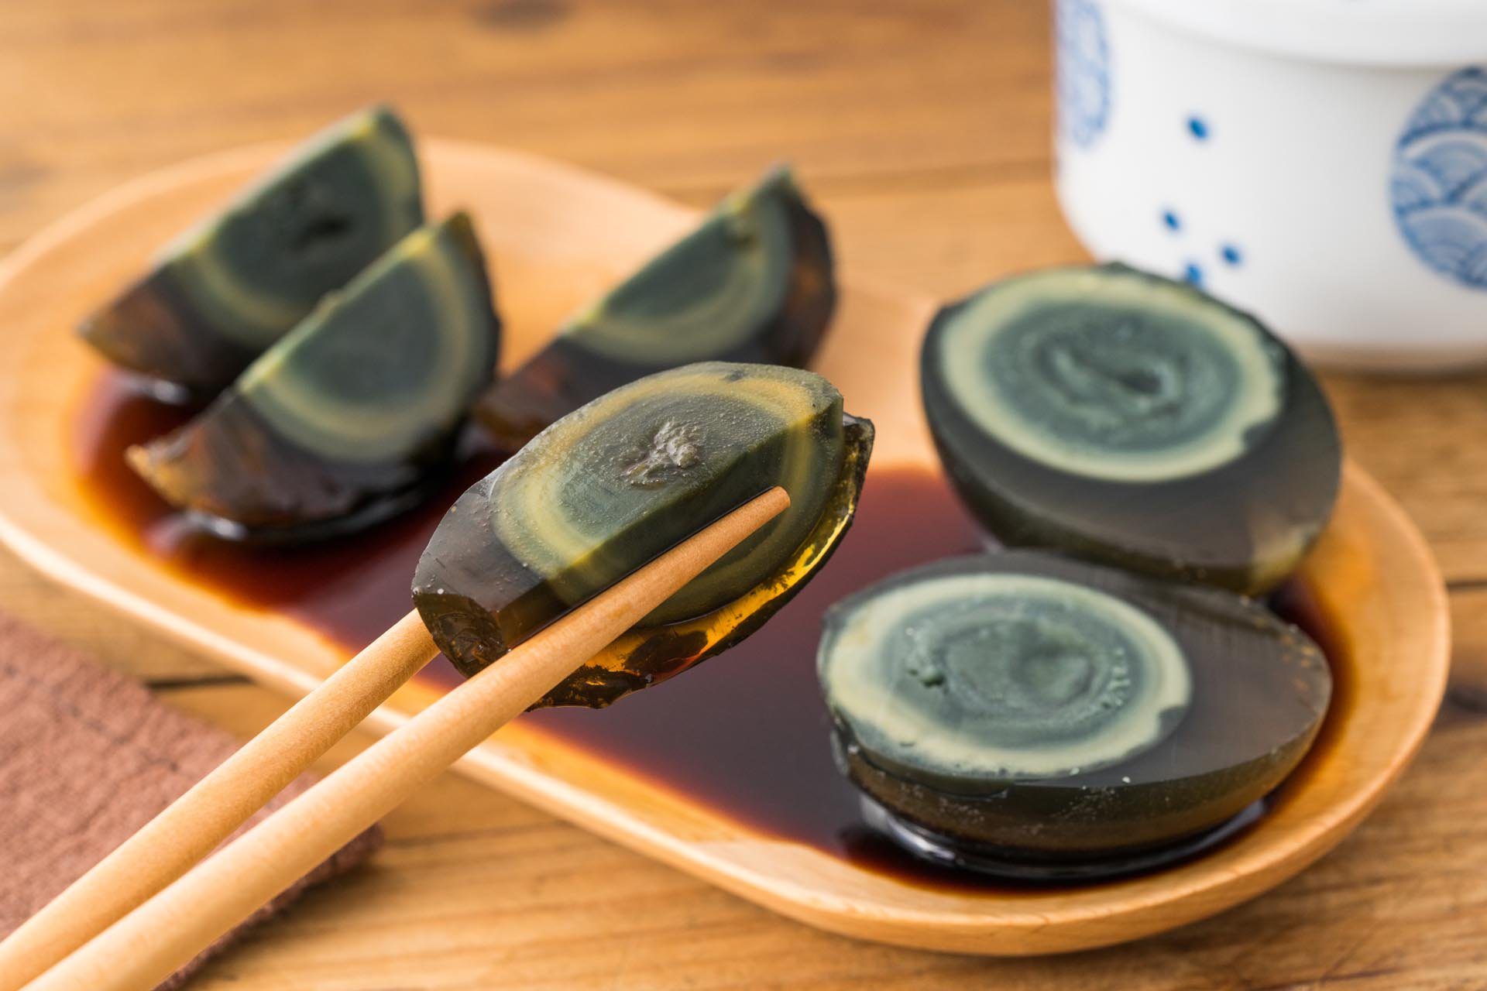
Umm… Would You Eat This?!

Slide 5
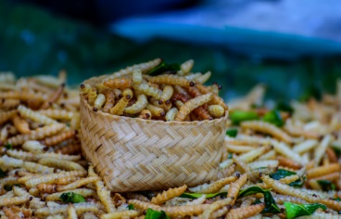
Umm… Would You Eat This?!

Slide 6
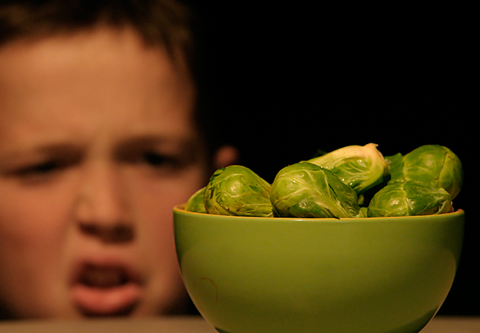
What’s Prejudice?
Prejudice is: an opinion that is not based on fact
EG: I might decide I don’t like brussel
sprouts without ever having tasted them.
Can you think of any examples?

Slide 7
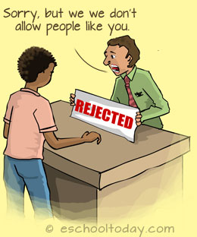
What’s Discrimination?
Discrimination is: acting on prejudice

Slide 8
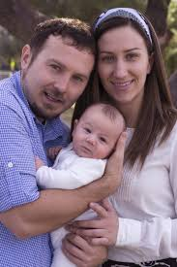
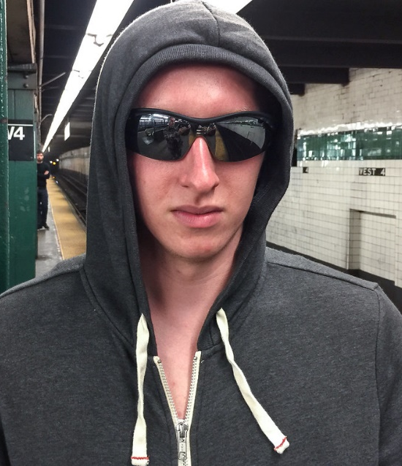
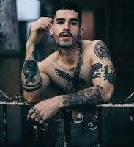
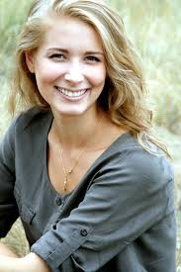
Pick Your Neighbour

Slide 9
What have we learnt today?
Notes:
9

