Slide 1
My Friend Frankie
Notes:
1

Slide 2
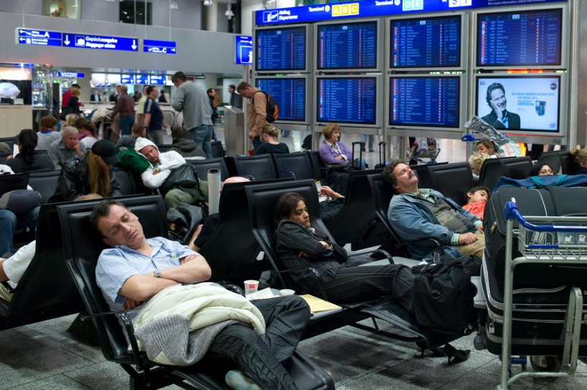

Slide 3
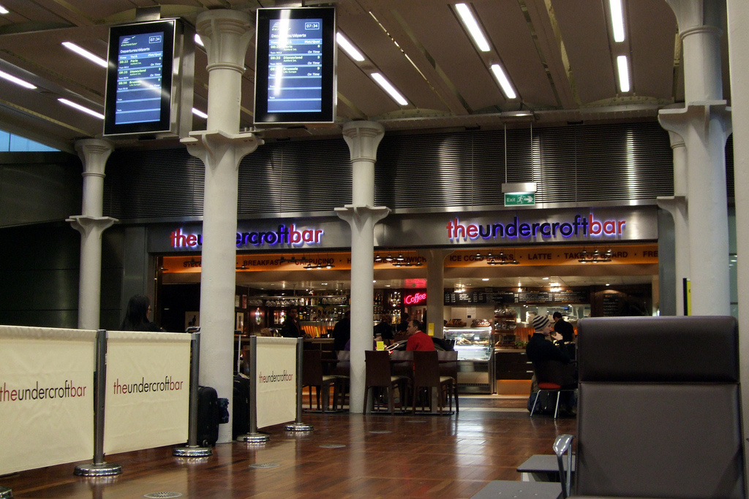

Slide 5
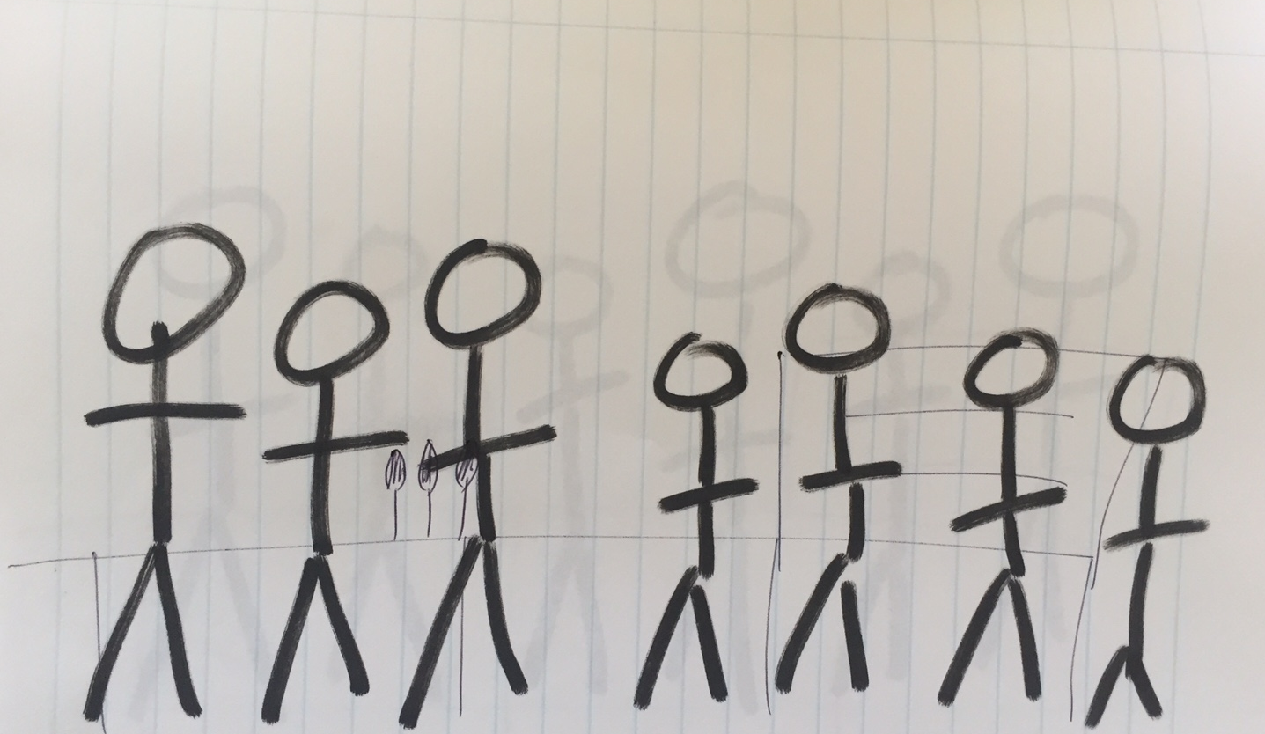

Slide 6
Can you now draw what you saw
in the two previous slides?

Slide 7
Let’s look at the results…

Slide 8
What is a Stereotype?
To believe unfairly that all people with a particular characteristic (e.g. girls/football fans/school children) are the same

Slide 9
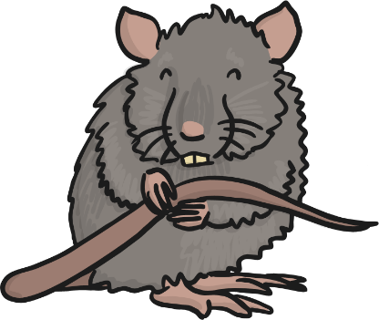
My Friend Frankie
Here are some facts about my friend, Frankie. Can you draw Frankie?
Frankie loves going to the rugby
Frankie wants to join the army
Frankie has a pet rat, called Roland

Slide 10
My Friend Frankie
We shouldn’t assume that Frankie is a boy, or a girl solely based on name, interests, career choice or pets!

Slide 11
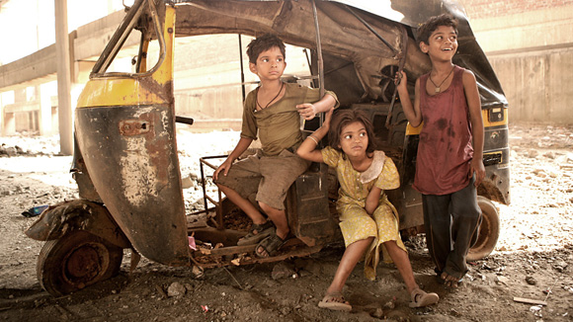
What stereotypes would you attach to this image?

Slide 12
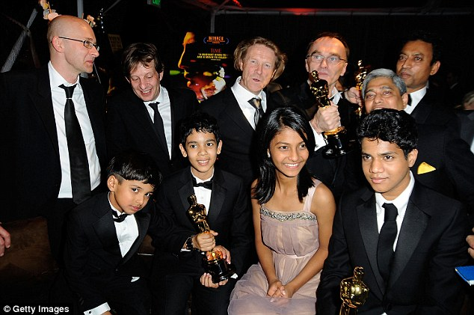
Are these the stereotypes you had in mind?
Successful
Award Winning
Talented

